Slide 1


Models and MTV Pattern
SoftUni Team
Technical Trainers
Software University
https://softuni.bg

Slide 2
Table of Contents
What is a Model?
Set up Database
Django Admin
MTV Pattern
CRUD
2

Slide 3
Have a Question?
sli.do
#python-web

Slide 4

What is a Model?

Slide 5
Model Definition
A model is the single, definitive source of information about your data
It contains the essential fields and behaviors of the data you're storing
Generally, each model maps to a single database table
Each model is a Python class that subclasses django.db.models.Model
Each attribute of the model represents a database field

Slide 6
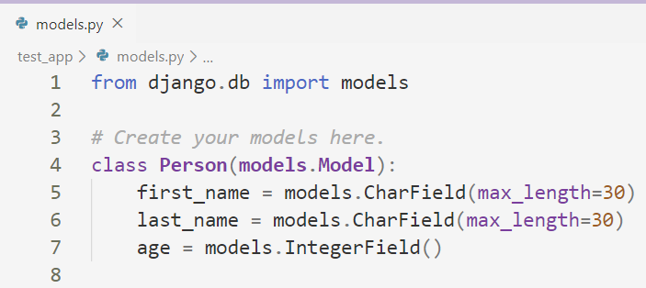
The models.py File
In each application we have a models.py file
In there we create all our models that will be used in the application
Model Name
Fields

Slide 7
Basic Model Fields
BooleanField - a True/False field (default for CheckboxInput)
CharField - small- to large-sized strings (used with max_length)
DateField - a date represented by datetime.date
FloatField and IntegerField - self explanatory
URLField - CharField for URL's (validated by URLValidator)
TextField - Large text Field (used for Textarea)

Slide 8
Relationship Fields
ForeignKey - Many-to-one relationship; requires two positional arguments: the class to which the model is related and the on_delete option
ManyToManyField - Many-to-many relationship; requires a positional argument: the class to which the model is related
OneToOneField - One-to-one relationship; similar to ForeignKey with unique=True, but the "reverse" side of the relation will return a single object

Slide 9

Set up Database

Slide 10
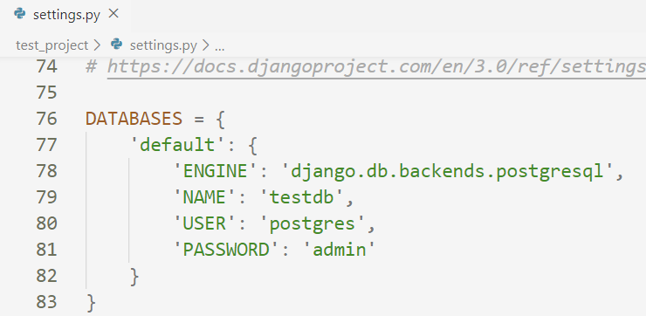
Set up PostgreSQL
To configure our project to work with PostgreSQL, we need to set it up in the settings.py file
Use postgreSQL
Name of the database
Database user credentials

Slide 11
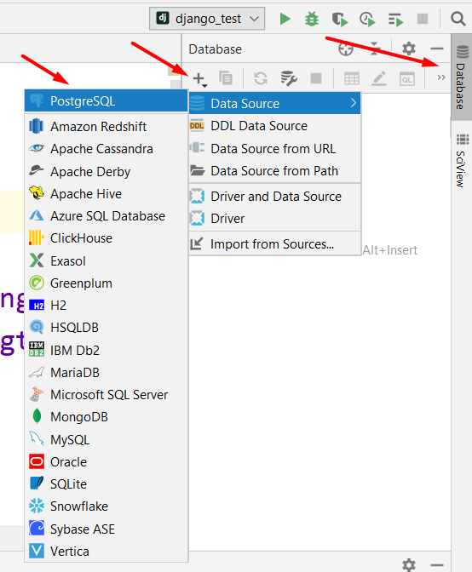
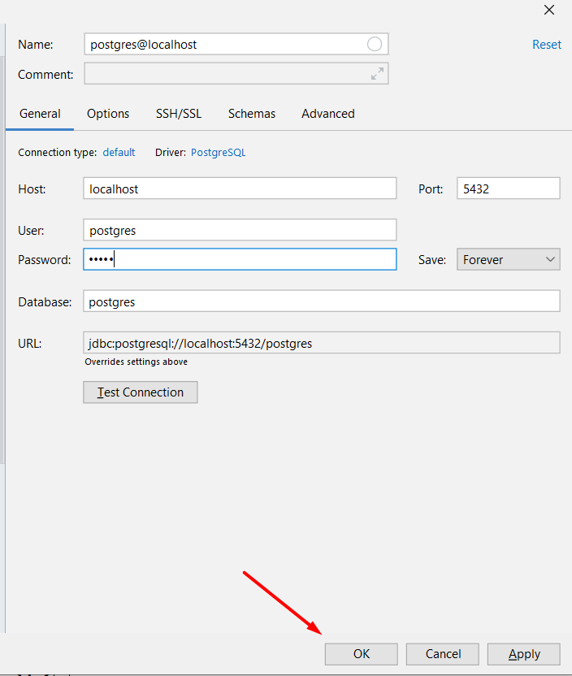
Connect to PostgreSQL

Slide 12
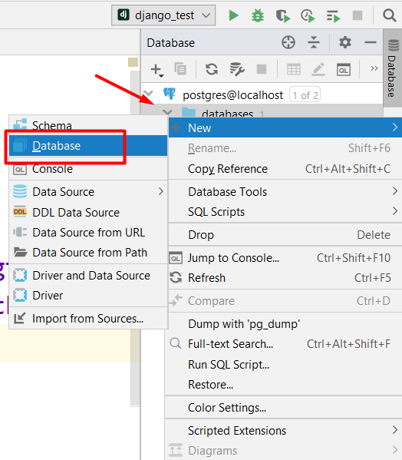
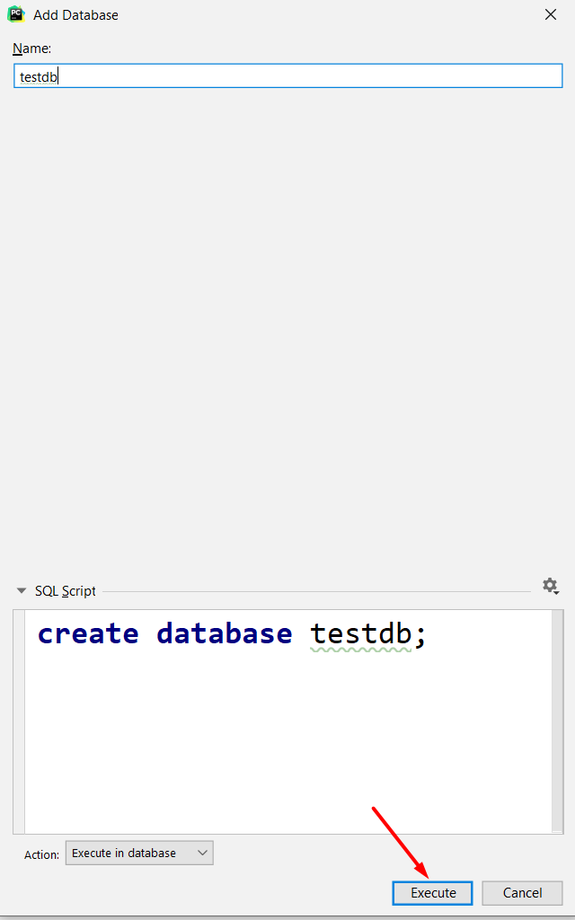
Create Database
Name of the Database

Slide 13
Applying Changes
In order to apply the changes we made in our models, we use migrations
During a migration against the database, there are series of migrations that Django requires that create tables to keep track of administrators and sessions
python manage.py makemigrations
python manage.py migrate

Slide 14
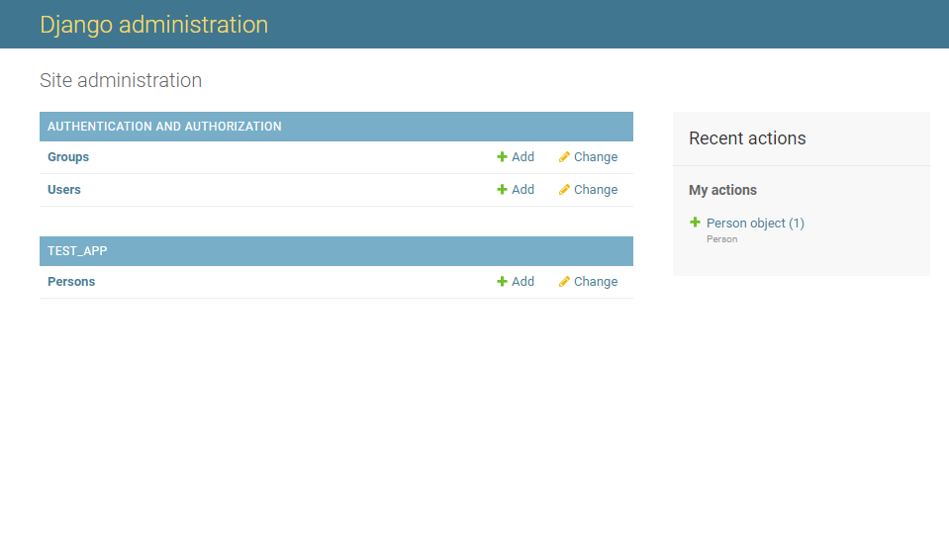
Django Admin

Slide 15
Django Admin
Django Admin is an automatic admin interface
It reads data from your models to provide interface where users can manage the content of the application
The admin is enabled in the default project template used by startproject

Slide 16
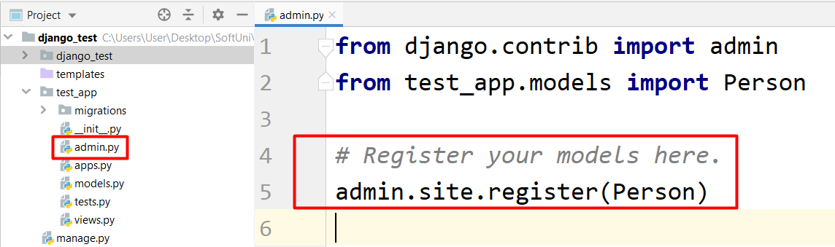
The admin.py File
In order to see the data in Django Admin, we need to register all the models in a special file in our app called admin.py

Slide 17
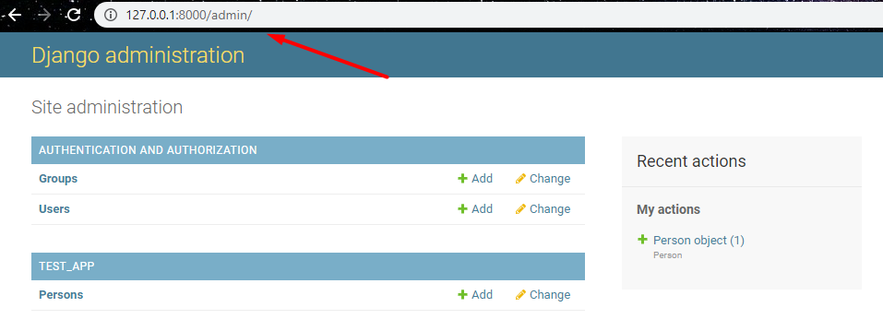
Access Django Admin
To access the Django Admin, you need a superuser
To create a superuser, we use the following command
After that, we start our project and navigate to the admin site
python manage.py createsuperuser

Slide 18
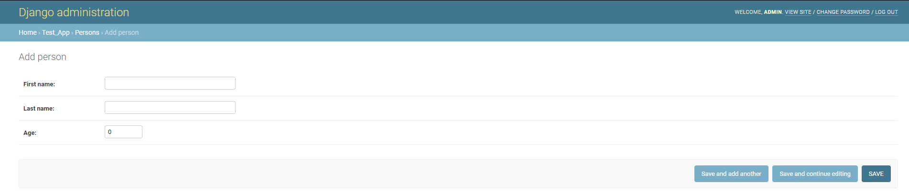
Django Admin Benefits
In the Django Admin we can manage the data stored in our database
We can manually create, update and delete data from the database

Slide 19
The MTV Pattern
MTV
Model Template View

Slide 20
What MTV Means
MTV is a software architecture pattern that separates data presentation from the logic of handling user interactions
MTV stands for Model, Template, View
Model - Logical data structure
View - Data formatting and business logic
Template - Presentation layer (data display)

Slide 21
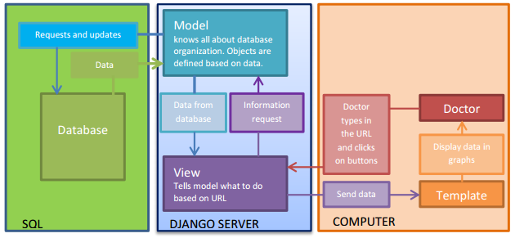
How MTV Works

Slide 22
CRUD
CRUD
Create, Read, Update, Delete

Slide 23
What is CRUD?
In computer programming, create, read, update, and delete (CRUD) are the four basic functions of persistent storage
Alternate words are sometimes used when defining the basic functions of CRUD, such as retrieve instead of read, modify instead of update, or destroy instead of delete

Slide 24
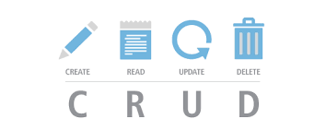
CRUD in Django
Once you've created your data models, Django automatically gives you a database-abstraction API that lets you create, retrieve, update and delete objects

Slide 25
Create
In order to create an object, we use the standard syntax for creating an object
When we are ready, we just use the save() method to save the object in the database
>>> from test_app.models import Person
>>> person = Person(first_name="John", last_name="Smith", age=35)
>>> person.save()

Slide 26
Read
To get all objects
To get a specific object
To filter objects
Field lookups
>>> from test_app.models import Person
>>> all_people = Person.objects.all()
>>> from test_app.models import Person
>>> all_people = Person.objects.get(first_name="John")
>>> from test_app.models import Person
>>> all_people = Person.objects.filter(age=35)
Less than or equal
>>> from test_app.models import Person
>>> all_people = Person.objects.filter(age__lte=35)

Slide 27
Update
To update an object, we have to retrieve it, change the fields we want to and save it again
>>> from test_app.models import Person
>>> person = Person.objects.get(pk=1)
>>> person.age = 36
>>> person.save()
Primary Key

Slide 28
Delete
To delete an object, we need to retrieve it and then use the delete() method to remove it from the database
>>> from first_app.models import Person
>>> person = Person.objects.get(pk=1)
>>> person.delete()

Slide 29

Live Demo
Applying the MTV Pattern

Slide 30
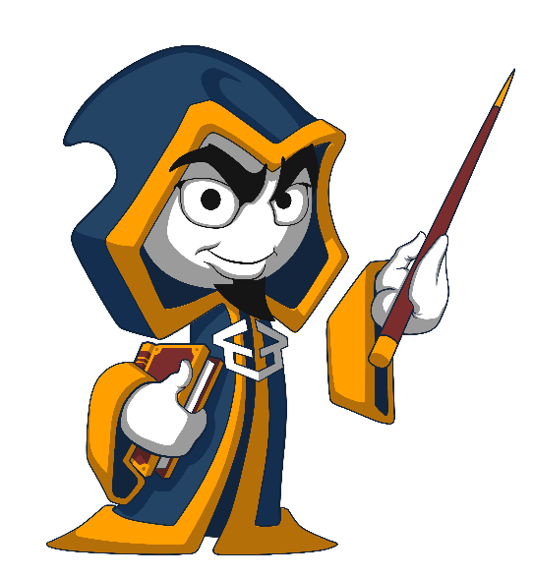
Summary
A model is definitive source of information about your data
Django Admin is automatic admin interface
MTV stands for Model View Template

Slide 31
Questions?
Notes:
31

Slide 32










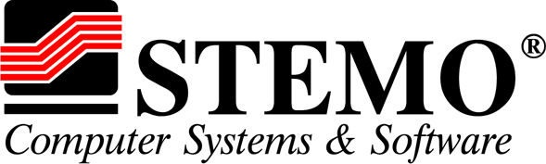

SoftUni Diamond Partners

Slide 33




SoftUni Organizational Partners

Slide 34

License
This course (slides, examples, demos, exercises, homework, documents, videos and other assets) is copyrighted content
Unauthorized copy, reproduction or use is illegal
© SoftUni – https://softuni.org
© Software University – https://softuni.bg
Notes:
34

Slide 35
Trainings @ Software University (SoftUni)
Software University – High-Quality Education, Profession and Job for Software Developers
softuni.bg, softuni.org
Software University Foundation
softuni.foundation
Software University @ Facebook
facebook.com/SoftwareUniversity
Software University Forums
forum.softuni.bg
35
Notes:
35

